Slide 1
Data Journalism
Teemo Tebest, EBU
Notes:
INTRODUCTION

Slide 2
Teemo Tebest
Data Journalist since 2013
Worked at Yle Plus Desk, a team of 8 people including graphic designers and coding journalists
Huge success: most read stories, international prices, leading the industry
Driving the change towards online platforms
Notes:
MOTIVATION: My Background and why data journalism is relevant and why members should be interested

Slide 3

Why?
Data is everywhere
EBU is responding to the ever changing media landscape
Shift towards online platforms
New ways of telling stories
Help the members to catch up with data journalism
Support of cooperation between members on new technology
Notes:
What is EBU’s role and why is EBU investing in a data journalist

Slide 4
Data Journalism?
Data is everywhere
Data journalism is a journalism specialty reflecting the increased role that numerical data is used in the production and distribution of information in the digital era
Infographics
Data-driven Journalism
Data Visualisations
Interactive Visualisations
News Games
Source: Wikipedia
Notes:
What is data journalism.

Slide 5

What?
Visiting SRF data team
Creating and expanding the community and awareness
Providing data journalistic content for the members to use
Encouraging and supporting cooperation between members including an exchange of data stories from one member to another
Notes:
What have we done so far.

Slide 6
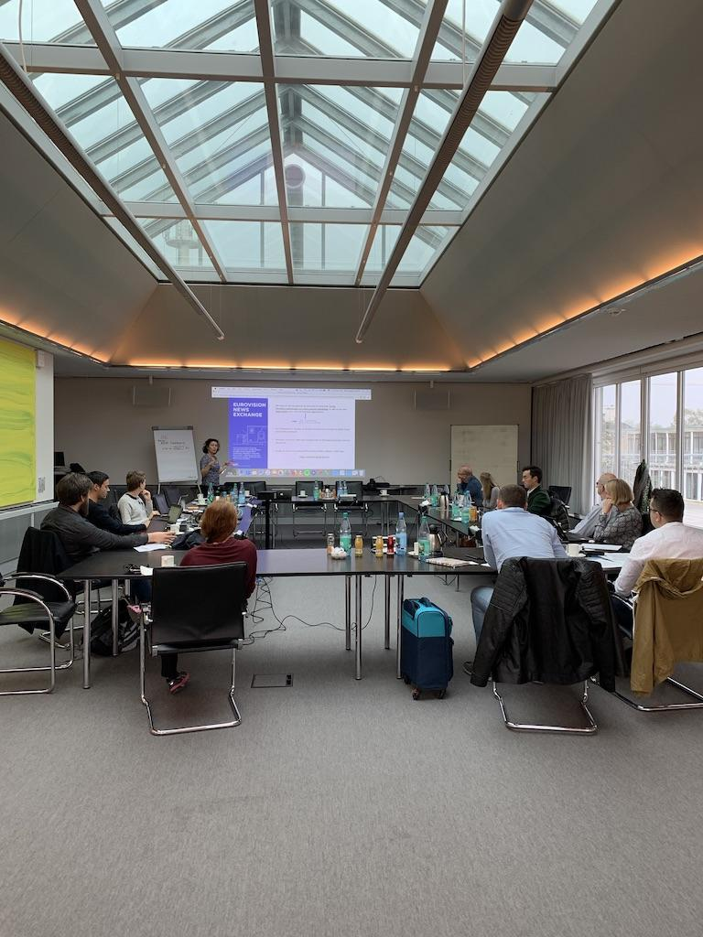
Building the Community
Hamburg workshop
We have a growing Facebook group which is used to share stories, share ideas and share knowledge between members
People from Lithuania to Marokko and from Sweden to Italy
In September we organized an event in Hamburg with the help of NDR
Notes:
The community.

Slide 7
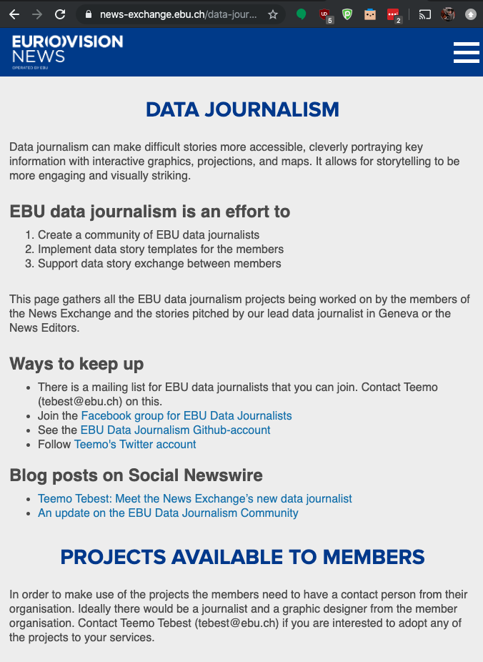
Data Stories
News Exchange
We have introduced a collection of data story templates for the members to use
We provide data stories via the News Exchange and the Social Newswire
We need to raise the awareness of this service
Notes:
Data Stories

Slide 8
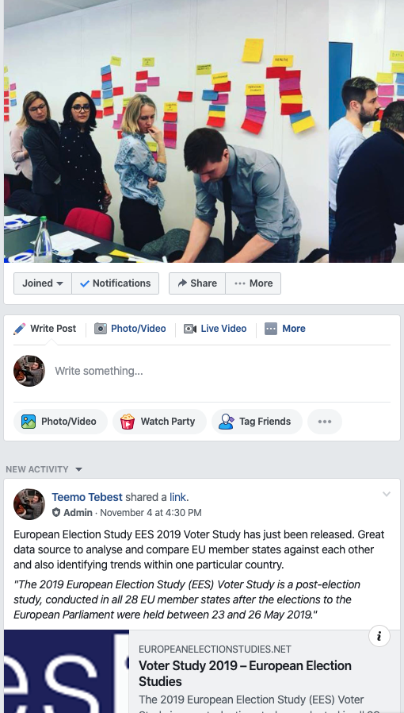
Cooperation
Facebook group
We are encouraging and asking members to share what they have done
Sharing stories and experiences on Facebook
Cross-border projects are encouraged
Possibilities for cooperation are limitless and we are trying to find the best ways to do it
Cooperation between members but also between members and EBU
Notes:
Cooperation between members

Slide 9

Next steps?
We want to grow and activate the community and contact the members individually in the near future
We are also keen to provide even more content for the members
We have plans to work together with the EBU Academy to provide training of data journalism
We are investigating the possibility to start a data journalists exchange
Notes:
What are the main objectives for next year.

Slide 10


FOLLOW THE EBU
@teelmo Teemo Tebest
@EBU_HQ
facebook.com/EBU.HQ
linkedin.com/company/ebu
instagram.com/ebu_hq/
EBU UPDATE monthly newsletter

